Slide 1

Dungeon Crawler
By Alex Blair

Slide 2
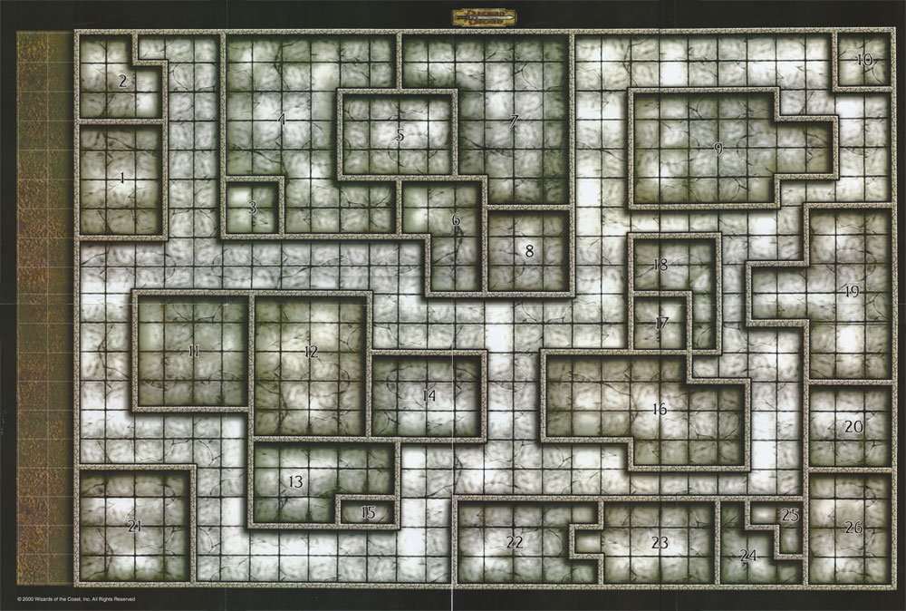
Idea
My idea was to make a text based dungeon crawler type of game where you, the hero, would move around a virtual space and fight monsters as well as explore.
It is completely based on text prompts and choices.
The original plan was to read all text from a .txt file and to parse it as needed, as well as develop a 2D GUI that the player could visually navigate through.

Slide 3
What went well?
I was able to implement a class hierarchy for the player, dungeon, chamber, combat, and enemy classes.
I used generics and data structures such as HashMaps to store information on my dungeon rooms.
Debugging, debugging, debugging
I learned what I struggle with and what I have a solid foundation in.

Slide 4

What do I need to do better?
Finish the GUI implementation and the file IO text processing.
Fix bugs
Create more enemies and more user response options.

Slide 5


Future Plans?
I do plan to fully implement the GUI at the very least.
I also would like to make my dungeon crawler into an Android application.

Slide 6
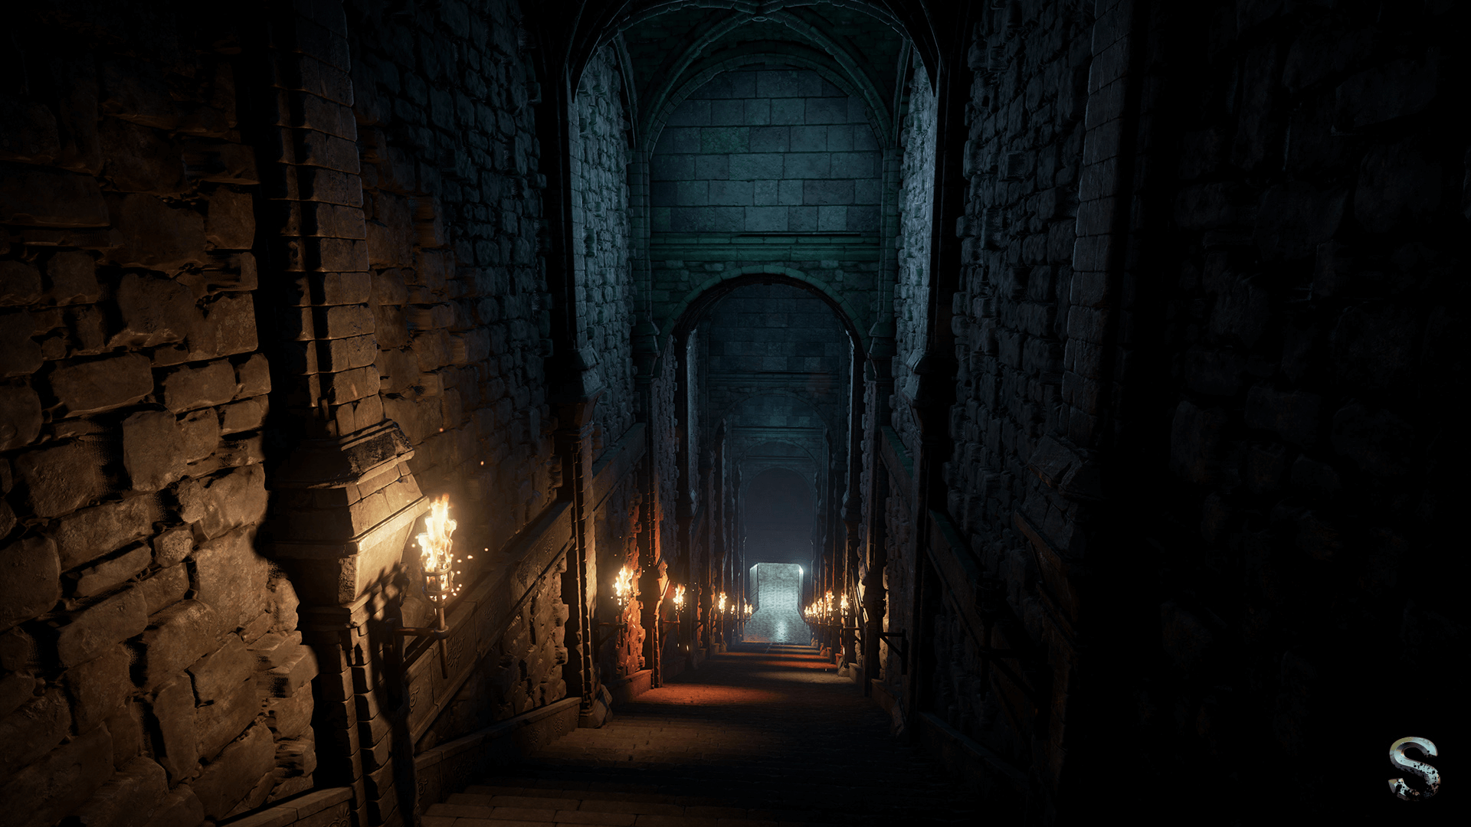
Demo
Demo Time!

Slide 7

Any Questions?

